Slide 1
Muni Performance and System Needs
San Francisco Board of Supervisors
Land Use and Economic Development Committee
SFMTA Municipal Transportation Agency Image: Historic Car number 1 and 162 on Embarcadero
5 | 28 | 2013
SAN FRANCISCO, CALIFORNIA

Slide 2
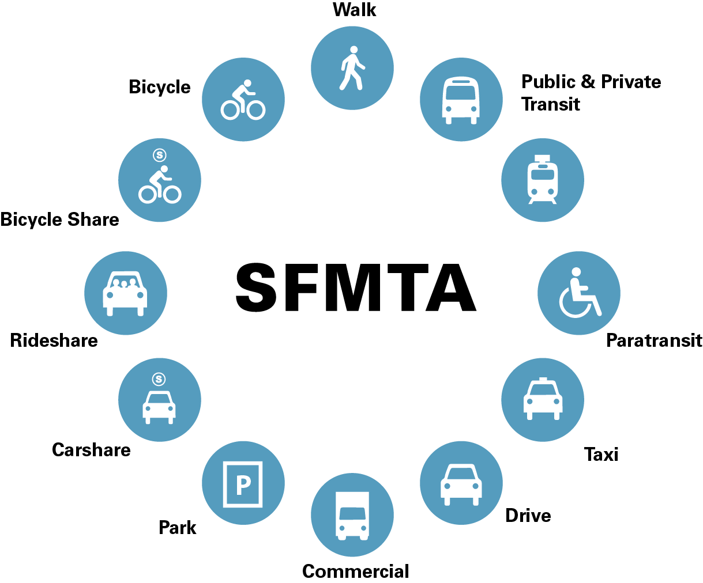
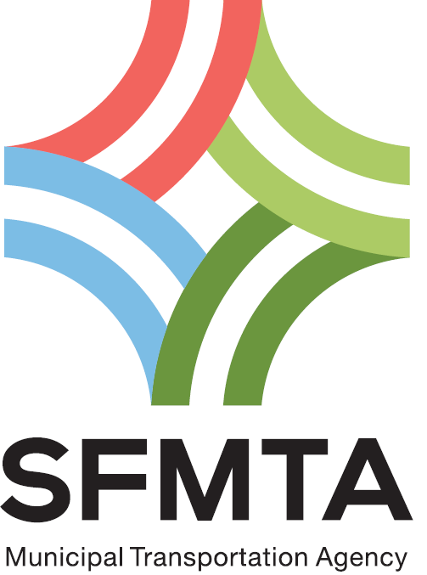
Who We Are

Slide 3
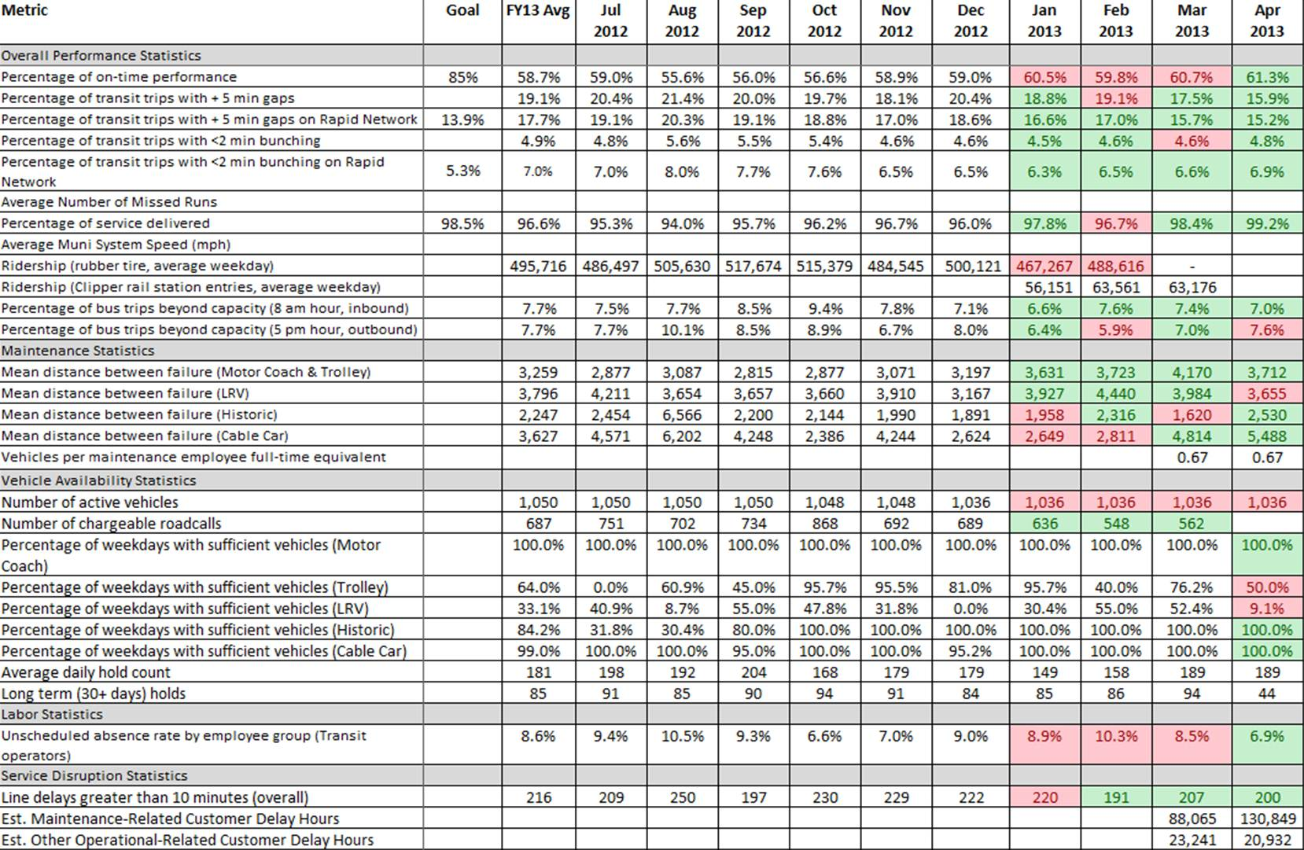
Performance Metric Areas
The SFMTA measures Muni service in the following key areas:
Overall Performance
Maintenance
Vehicle Availability
Labor
Service Disruptions

Slide 4
How are we doing?
Muni Today
Performance Metric | FY 2013 To Date | April 2013 | April 2012
On-Time Performance | 58.7% | 61.3% | 60.5%
Gaps | 19.1% | 15.9% | 20.5%
Percentage of Scheduled Service Delivered | 96.6% | 99.2% | 95.1%
Bus Crowding (over 100% capacity) | 7.7% (AM inbound) | 7.0% (AM inbound) | 5.9% (AM inbound)
 | 7.7% (PM outbound) | 7.6% (PM outbound) | 8.2% (PM outbound)
Vehicle Availability (Percentage of Weekdays with Sufficient Vehicles to Deliver Scheduled Peak Service) | 100.0% (Motor Coach) | 100.0% (Motor Coach) | 100.0% (Motor Coach)
 | 64.0% (Trolley Coach) | 50.0% (Trolley Coach) | 66.7% (Trolley Coach)
 | 33.1% (Train) | 9.1% (Train) | 9.5% (Train)
Mean Distance Between Failure (MDBF) | 4,602 (Motor Coach) 1,892 (Trolley Coach) 3,796 (Train) | 5,064 (Motor Coach) | 6,749 (Motor Coach) 1,578 (Trolley Coach) 3,765 (Train)
 |  | 1,917 (Trolley Coach)
 |  | 3,655 (Train)
Average Daily Hold Count (Vehicles unavailable for revenue service) | 181 | 189 | 195
Line delays (over 10 minutes) | 216 | 200 | 242
Estimated Customer Delay Hours | N/A | 151,263 (Maintenance-related) 20,932 (Other Operations-related) | N/A
 | Better than last year |  | Worse than last year
Notes:
John to explain:
OTP down slightly
Gaps are flat -
Service delivery is up
MDBF is up
Line delays are down
Delay hours estimated using average passengers per hour

Slide 5
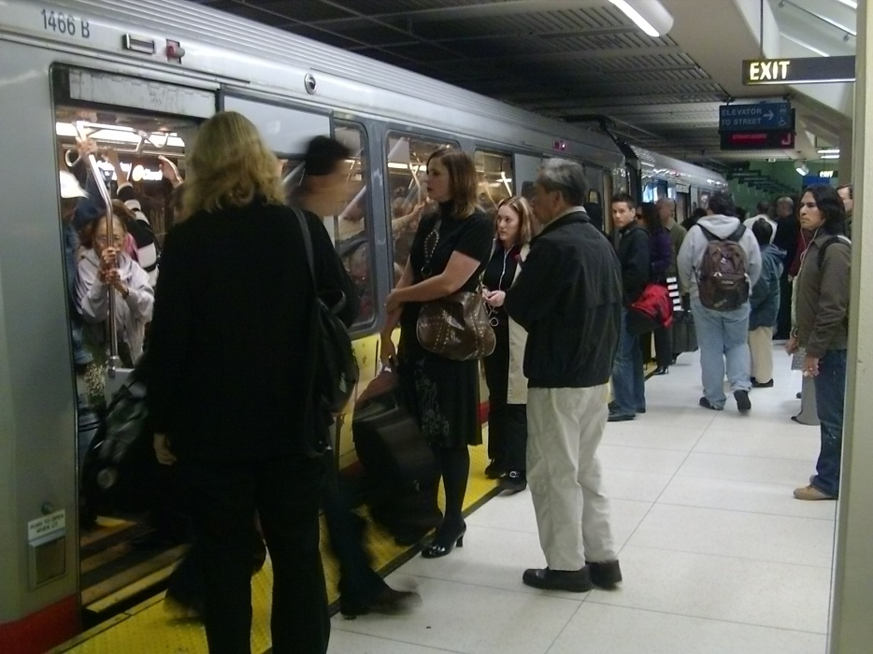
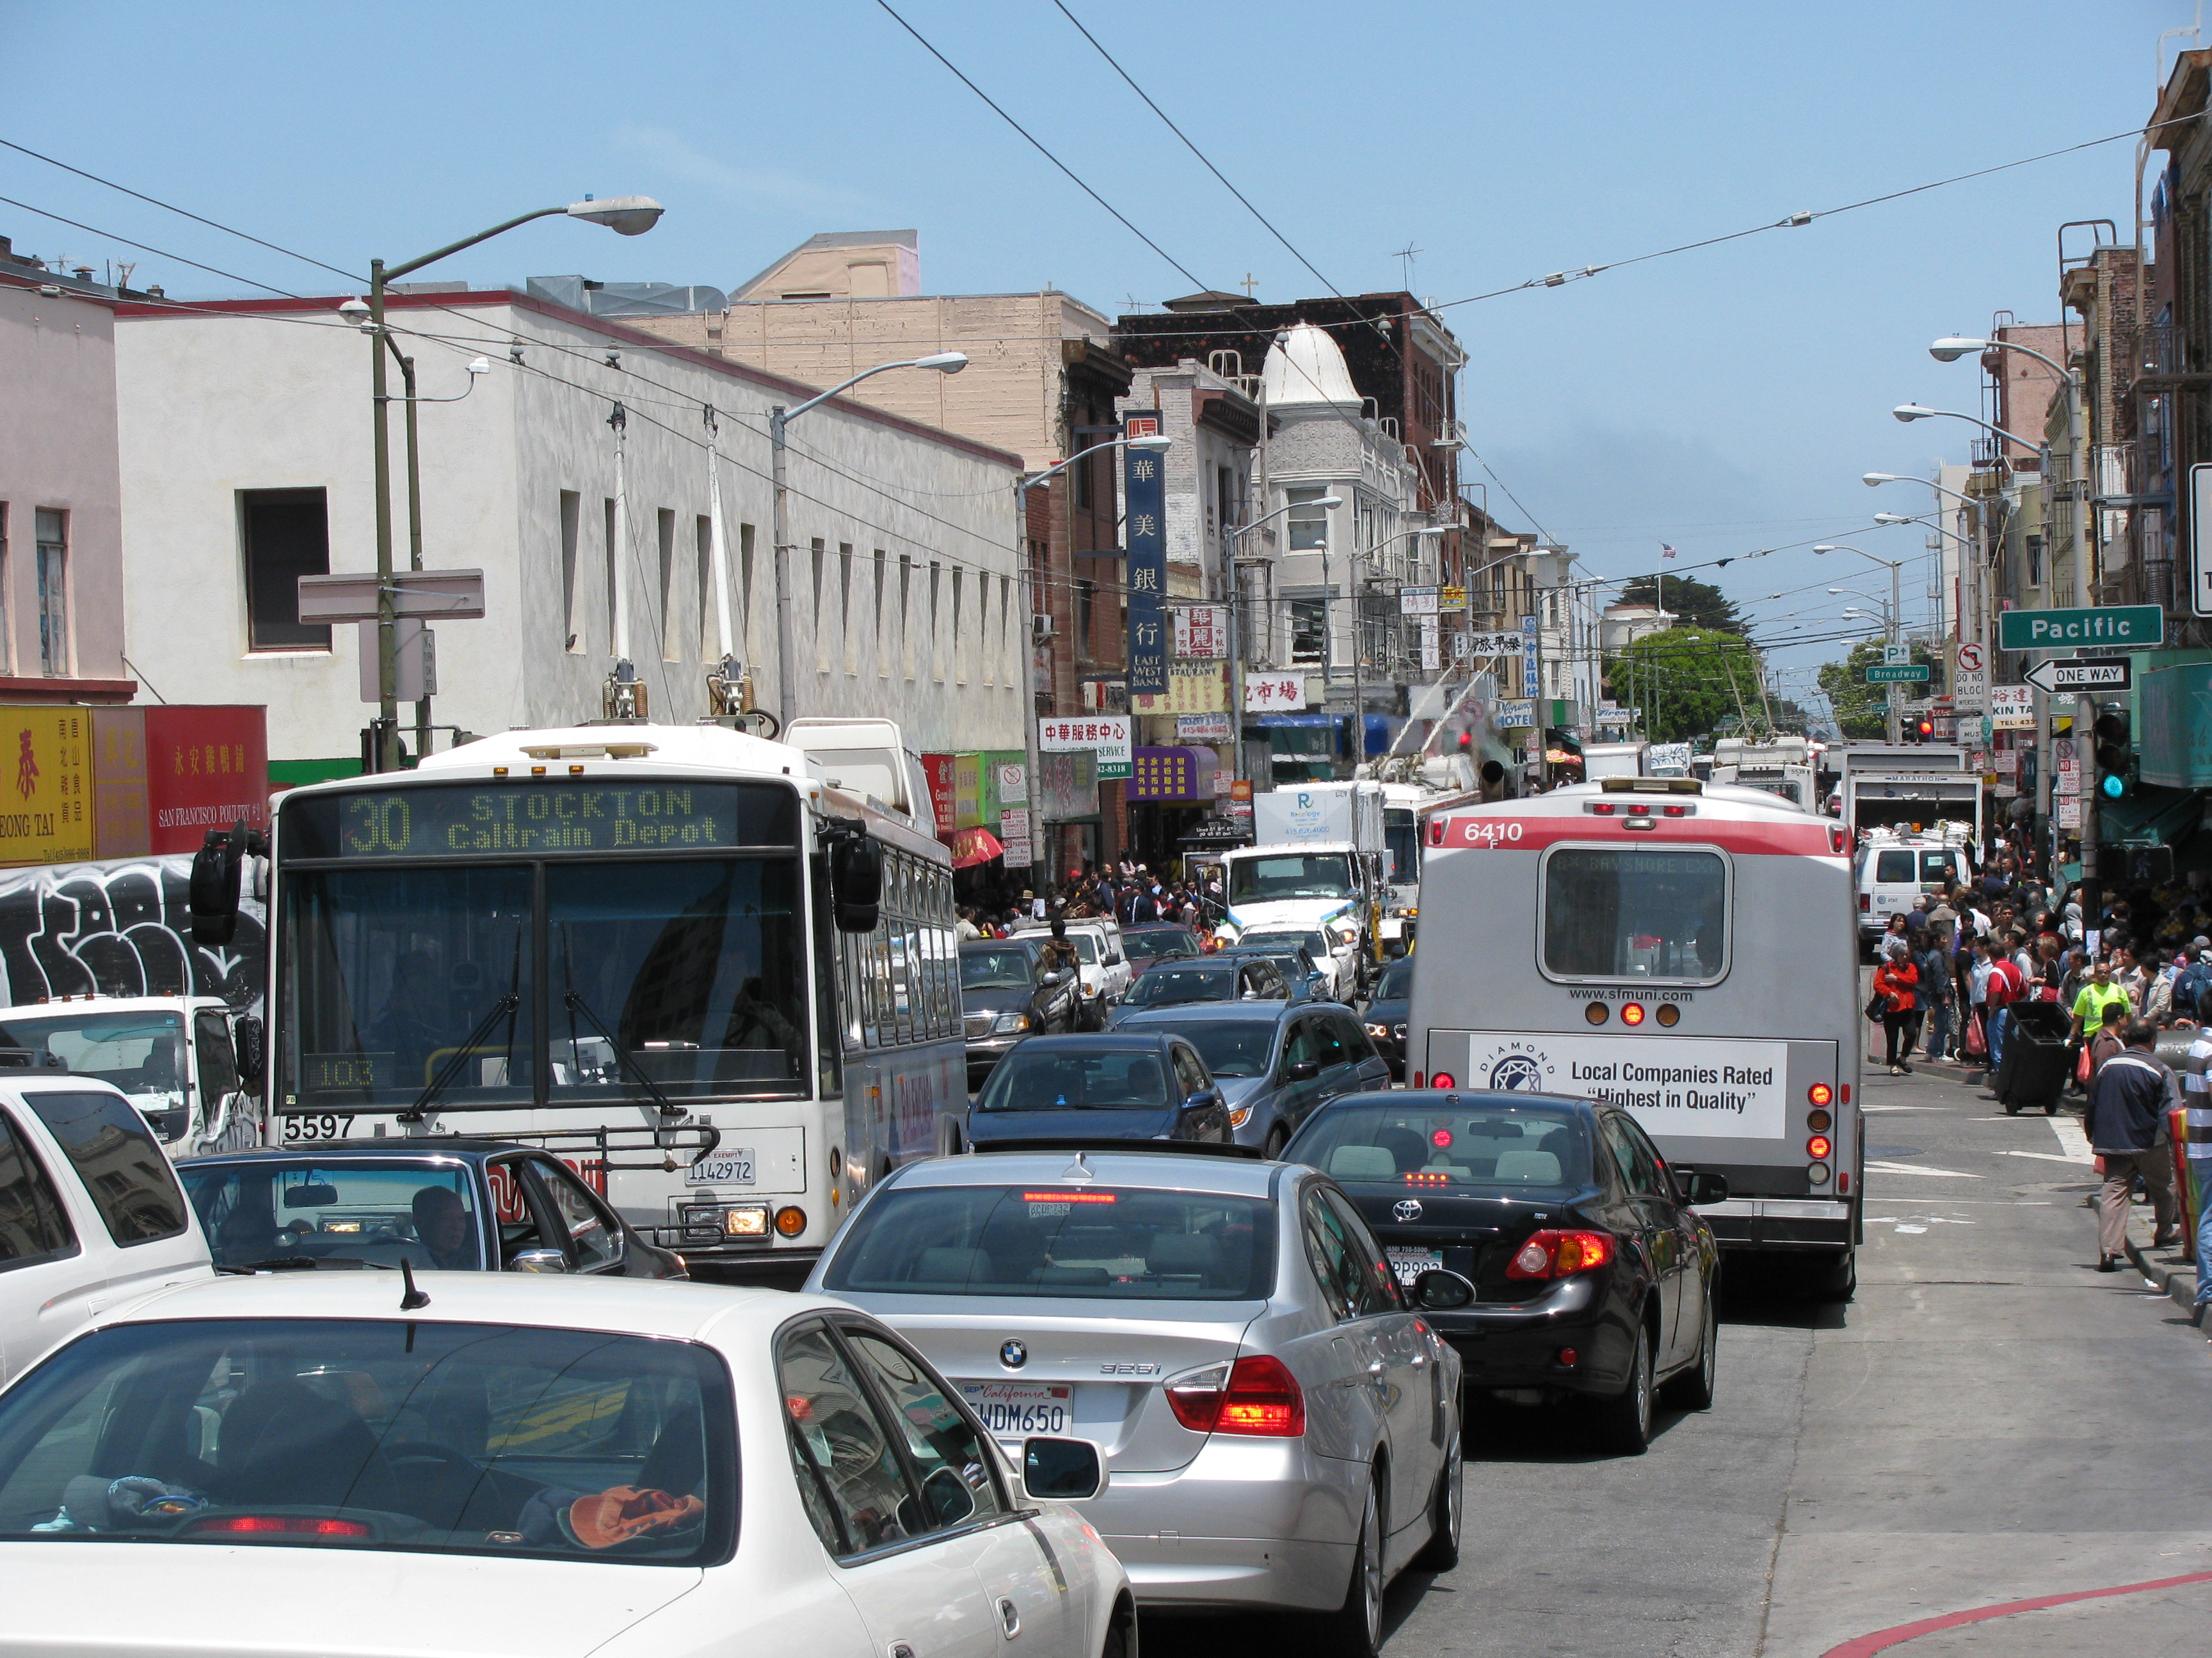
What affects Muni’s Performance Today?
Muni Today
Under-investment in the system
  Aging fleet and infrastructure
  Outdated technology
Insufficient operator, maintenance, and supervision staffing
  Not filling scheduled service
  Crowded vehicles
  Longer customer waits
Operating in mixed flow traffic
  Delays, service gaps, slow speeds
Crowding
Crowding
Traffic Delays

Slide 6
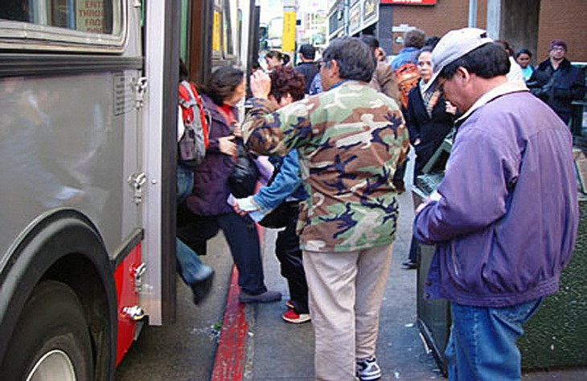
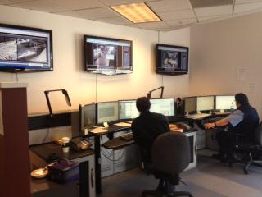
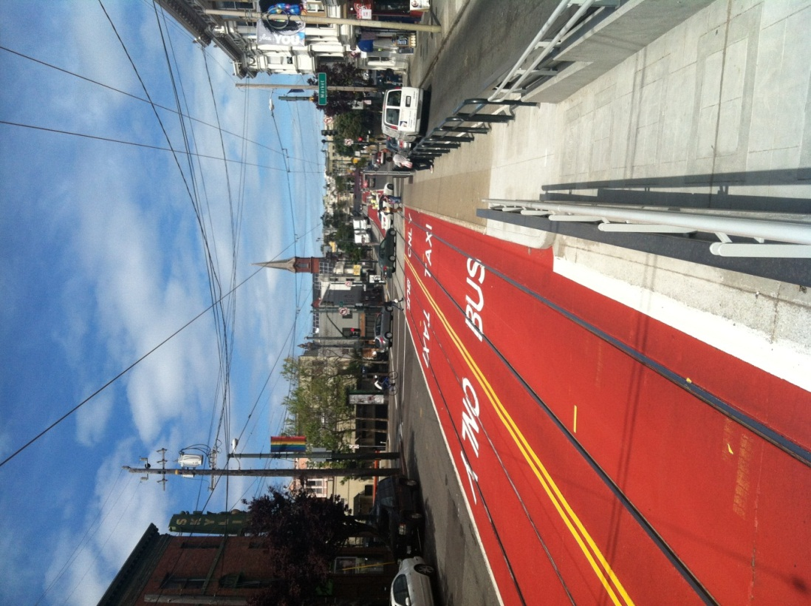
Initiatives to Improve Performance
Muni Today
Reducing travel times
  All-Door Boarding
  J Church priority lanes
Increasing system efficiency
  Transit Effectiveness Project (TEP)
  Customer First initiatives
Supervision
  Line Management Center
  Use of modern technology
Schedules
  More frequent and demand-based schedule adjustments
All Door Boarding
Dynamic Supervision
Transit Only Lanes
Scheduling Efficiencies

Slide 7
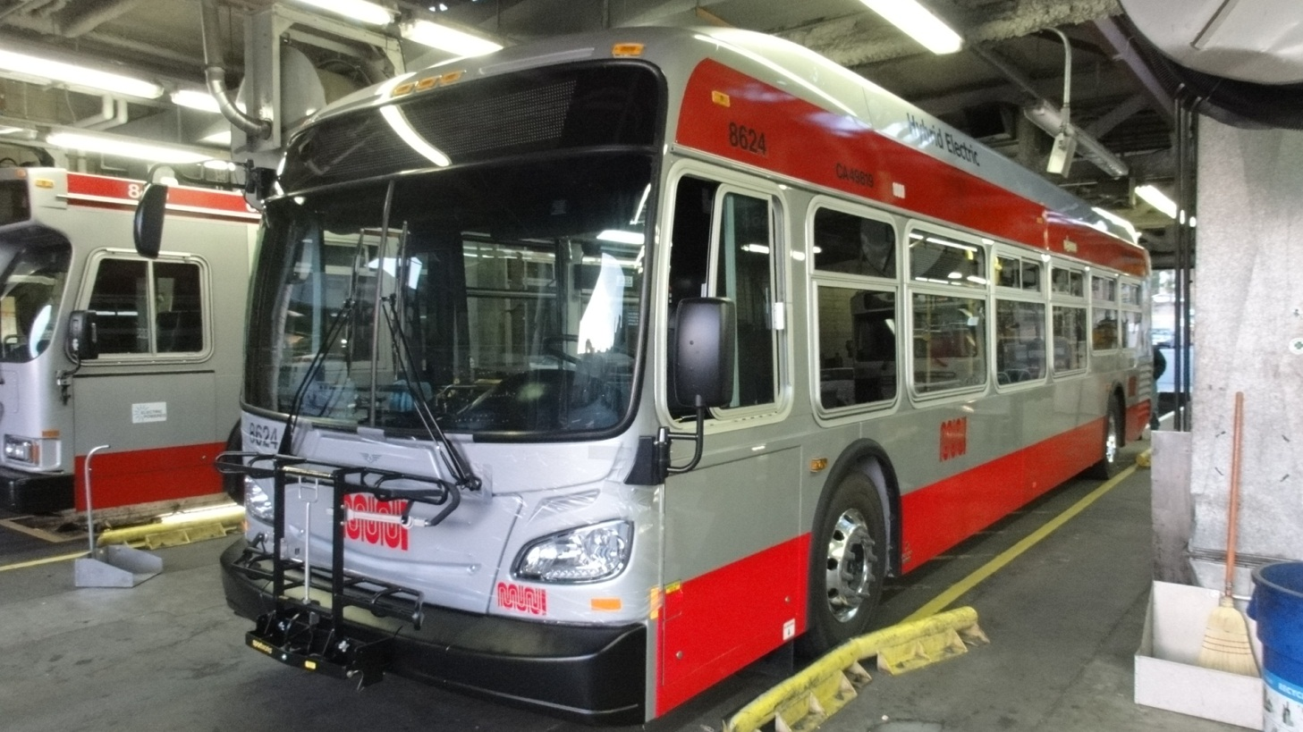
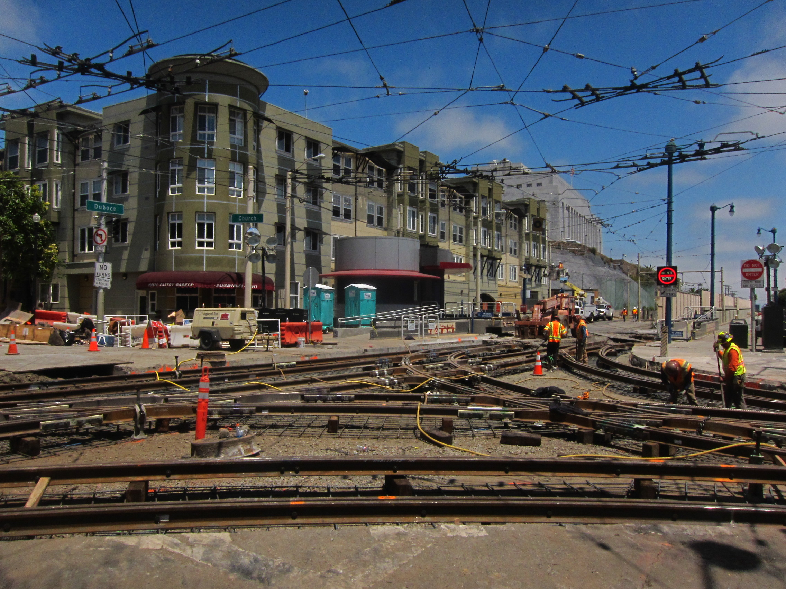
Initiatives to Improve Performance
Muni Today
  Realignment of capital program to address aging Transit fleet and infrastructure
Fleet and infrastructure rehabilitation and replacement
  Bus fleet replaced in next five years
  Rail replacements (Duboce, Sunset, etc.)
Focus on maintenance
  More comprehensive preventive maintenance
  Targeted component rehabilitation
Reduced subway delays
  Replacing worn infrastructure
  Clearing disabled trains faster
Fleet Replacement
Reduce Subway Delays
Infrastructure Rehabilitation

Slide 8
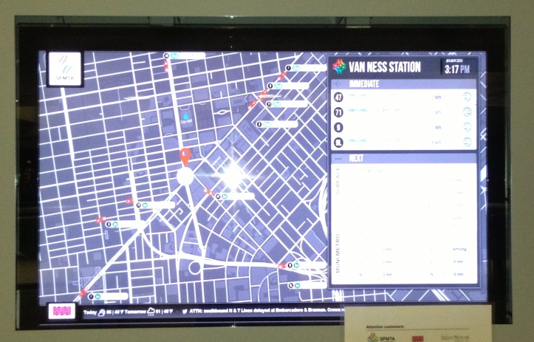
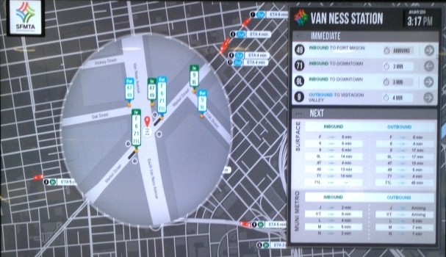
Improving Customer Communications
Muni Today
Communications
  Real-time customer communication via Twitter, NextBus and audio announcements
  New website
Customer Outreach
  Rider alerts
  New subway signage and audio system
  Pilot electronic signage
Improved Communications

Slide 9
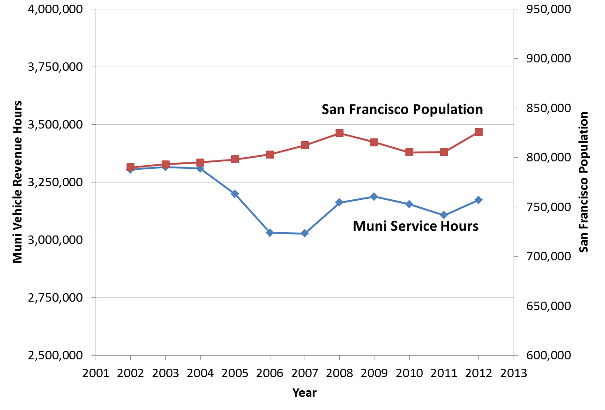
Investment Needed to Meet Today’s Needs
Muni Today
The SFMTA faces a $320M annual structural budget deficit
  $70M in unfunded operating needs ($50M for transit alone)
  $260M in State of Good Repair needs
Decades of under-investment have contributed to a system that does not meet Proposition E standards
Service levels have not kept up with recent population growth
Quality of service compromised
Notes:
How much is the Muni portion of the $250M capital shortfall?
Need to look more closely at these numbers

Slide 10
Transit System – State of Good Repair
Muni Today
The SFMTA has total assets of $12.35 billion
Assets classified as “Transit Service Dependent”
  Assets that directly impact the provision of transit services; reduce day-to-day maintenance and/or operating costs
  Total Transit Service Dependent Assets = $6.69 billion
  Deferrals = $680 million as of 2010
ASSET CLASS | TOTAL VALUE | % Deferred 2010
Light Rail Vehicles | $1,006 M | 2%
Motor Coach Vehicles | $1,168 M | 5%
Train Control and Communications | $876 M | 11%
Trolley Coach Vehicles | $742 M | 17%
Overhead Lines | $2,177 M | 17%
Track/Rail | $724 M | 22%
TOTAL | $6,693 M | 10%
Notes:
How much is the Muni portion of the $250M capital shortfall?
Need to look more closely at these numbers

Slide 11
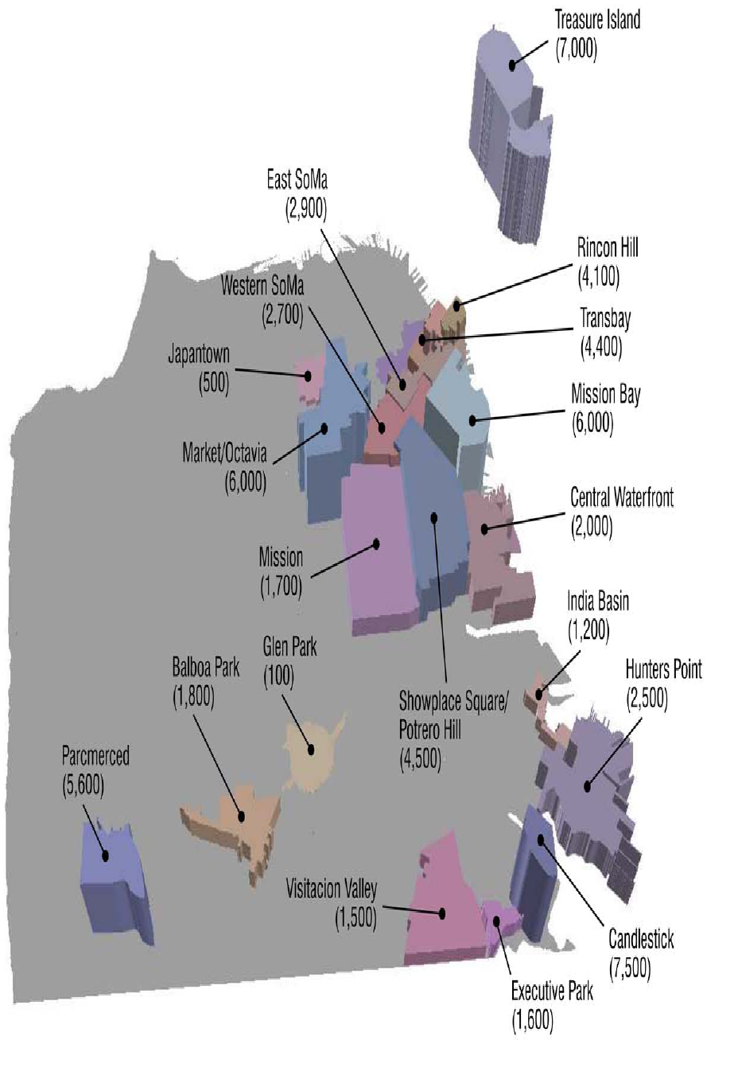
Muni Tomorrow
City’s 2035 Population & Job Growth
Requires More Transit
People = 920,230
(+15%)
Jobs = 625,000
(+25%)
Source: SF City Planning

Slide 12
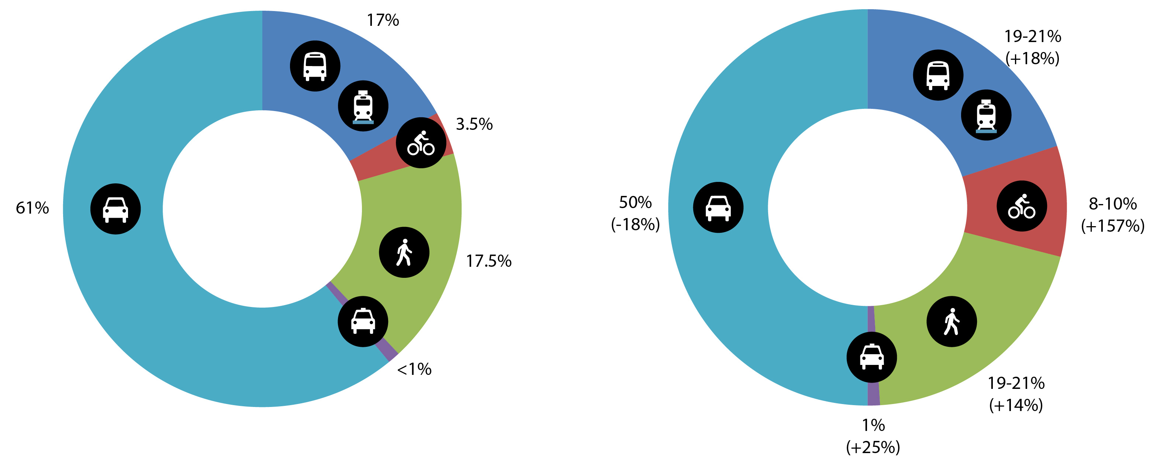
Quality of Life Depends on Mode Shifts to Sustainable Transportation
Muni Tomorrow
2010
2018 Goal
61% auto/39% non-auto
50% auto/50% non-auto

Slide 13
Residents Make Choices Based on the Quality of the Transportation System
Muni Tomorrow
Where to Live?
Where to Work?
Where to Shop?
How to Travel?
Willingness to pay for housing?

Slide 14
“Quality” Means Different Things
Muni’s Economic Value
Quality
Speed
Cost of Time
Comfort
Enjoyment
Travel Productivity
Out-of-Pocket Costs
Reliability
Access to jobs and shopping
Poor quality transportation reduces the quality of life in San Francisco

Slide 15
Economic Impacts of Low Quality Transportation
Muni’s Economic Value
Lower Quality of Life for Residents
Higher Labor Costs
Lower Property Values
Smaller Labor Pool for Businesses
Less Access to Skills
Higher Labor Costs
Weaker Competitiveness

Slide 16
Muni Delays, April 2013:
Impact on Commuters
Muni’s Economic Value
86,000 customer-hours* lost in peak-hour delays due to maintenance or other Muni-related reason.
Increased commute time for San Franciscans by 1.5%
Caused economic loss of $4.2 million ($50 million** annualized), due to higher costs and lower competitiveness.
* Total customer-hours in peak period estimated at 1,900,000
** Excludes the impacts of reduced shopping access and off-peak delays

Slide 17
Implications
Muni’s Economic Value
Reducing transit delays creates economic benefits.
Improving transit performance can create additional economic benefits.
Investment in Muni and other city transportation infrastructure can create economic benefits that exceed their cost.
Economic analysis of these benefits can help identify investments with the greatest potential return on investment.

Slide 18
Additional Funding Yields a Return on Investment
Muni’s Economic Value
Economic impact of delays is estimated at $50 million annually
With a $50 million recurring annual investment, here are examples of how the SFMTA could improve Muni service:
Replace 10 trains per year
Increase service by 8%
or
Meet service delivery goals
Improve on-time performance
Reduce gaps
Reduce crowding
Improve service frequency
Improve vehicle reliability
or
or
Rehabilitate 170 buses per year
Replace 64 buses per year
or
Notes:
This is not real money, but still should provide concrete examples of how Muni would improve if the City made the investment

Slide 19
Questions?

Slide 20
Reference Slides

Slide 21
Muni Performance Metrics
The following major performance metrics help illustrate how Muni performance impacts customer service
In support of Proposition E and the SFMTA Strategic Plan
Performance Metric | Methodology
On-Time Performance | Percentage of vehicles passing each timepoint within -1/+4 min. of schedule
Gaps | Percentage of vehicles passing each timepoint where gaps are at least 5 minutes longer than the route's scheduled headway
Percentage of Scheduled Service Delivered | Percentage of scheduled runs that are delivered
Bus Crowding | Percentage of buses that are over capacity at the maximum load point
Mean Distance Between Failure (MDBF) | Distance between vehicle breakdowns by vehicle type
Unscheduled Operator Absenteeism | Unscheduled absence rate for Transit Operators due to sickness or other reasons
Line delays | Number of line delays (at least 10 minutes long) as reported in the SFMTA's Central Control Log
Est. Customer Delay Hours | Estimated number of customer-hours of delay resulting from (a) maintenance-related line delays and (b) non-maintenance line delays related to Muni, such as accidents
Notes:
Included list is the “highlights”
List of all metrics in the appendix

Slide 22
Performance Metrics Methodology
Performance Metric | Methodology
Overall Performance
On-Time Performance | Percentage of vehicles passing each timepoint within -1/+4 min. of schedule
Gaps | Percentage of vehicles passing each timepoint where gaps are at least 5 minutes longer than the route's scheduled headway
Bunches | Percentage of vehicles passing each timepoint that are within 2 minutes of the previous vehicle on the same route
Percentage of Scheduled Service Delivered | Percentage of scheduled runs that are delivered
Average speed | Vehicle Revenue Miles/Vehicle Revenue Hours
Average weekday ridership | Bus - Average ridership by route Rail - Average Muni Metro subway station faregate entries
Bus Crowding | Percentage of buses that are over capacity at the maximum load point
Maintenance and Vehicle Availability
Mean Distance Between Failure (MDBF) | Distance between vehicle breakdowns by vehicle type
Maintenance Staffing | Vehicles per Maintenance employee full-time equivalent (FTE)
Number of Active Vehicles | The current number of active light rail vehicles, diesel coaches, and electric trolleys available on the property

Slide 23
Performance Metrics Methodology
Performance Metric | Methodology
Maintenance and Vehicle Availability (continued)
Number of Vehicle Breakdowns | Number of breakdowns, as reported in the SFMTA's Central Control Log
Vehicle Availability | Percentage of weekdays in which there are sufficient vehicles available to meet scheduled service requirements by vehicle mode
Hold count | The average daily number of bus and rail vehicles that are kept out of service for all maintenance activities
Long term holds | The number of bus and rail vehicles that are kept out of service for over 30 days
Operator Absenteeism
Unscheduled Operator Absenteeism | Unscheduled absence rate for Transit Operators due to sickness or other reasons
Service Disruptions
Line delays | Number of line delays (at least 10 minutes long) as reported in the SFMTA's Central Control Log
Estimated Customer Delay Hours | Estimated number of customer-hours of delay resulting from (a) maintenance-related line delays and (b) non-maintenance line delays related to Muni, such as accidents

Slide 24
Sample Report

Slide 25
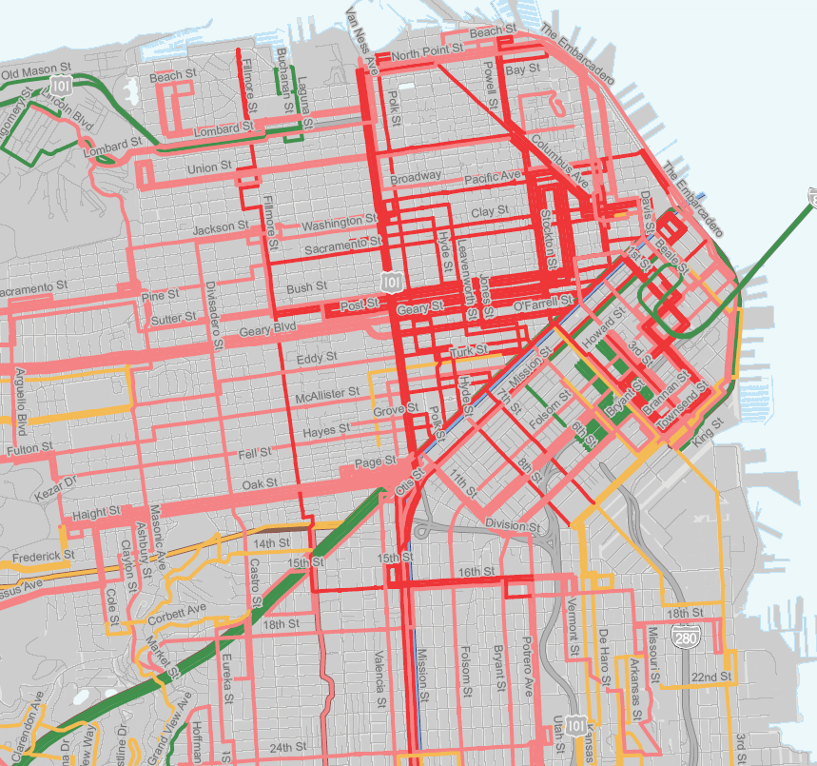
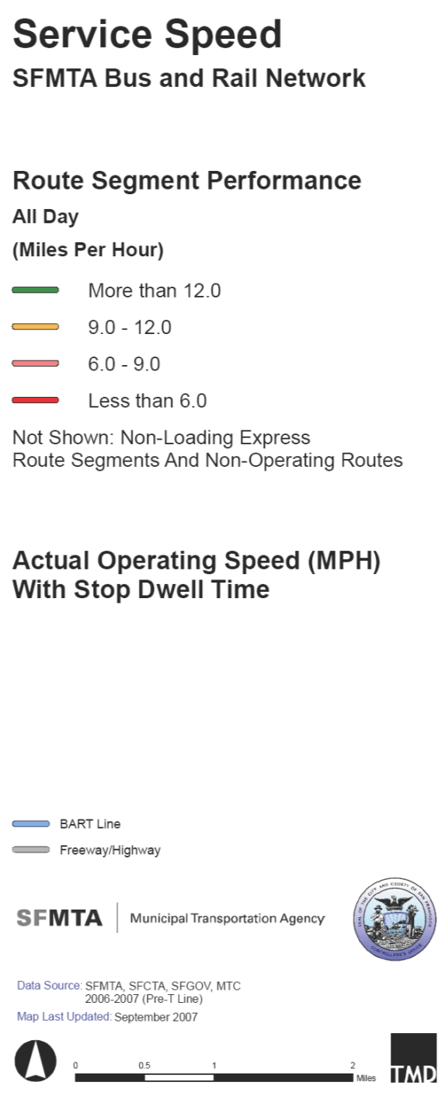
Slow travel times frustrate customers and increase Muni costs

Slide 26
















Bus route…60 min running time
30 minutes
30 minutes
Round Trip Travel Time = 60 minutes
60
Bus every 10 minutes = = 6.0 => 6 buses + 6 drivers
10
Notes:
Mention other causes of delays… too many stop signs and closely spaced stops

Slide 27
Remove congestion…reduce time, reduce resources
30 minutes
25
30 minutes
25
Round Trip Travel Time = 60 minutes
50
50
Bus every 10 minutes = = 5 buses + 5 drivers
10
17% decrease in cost and travel times!

Slide 28
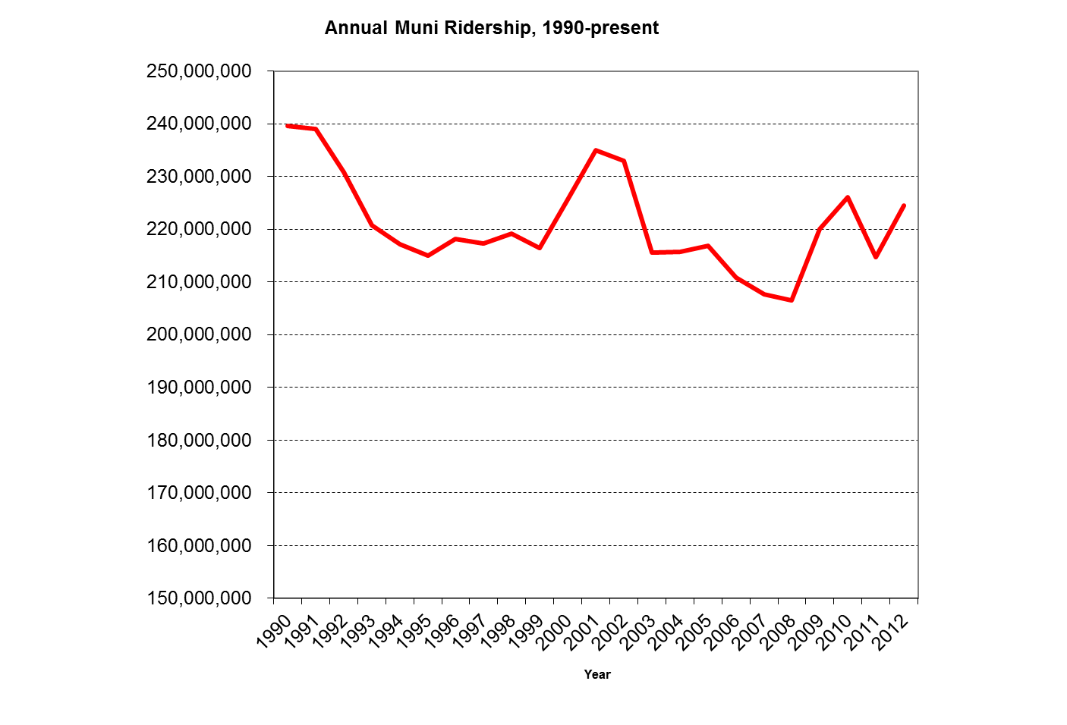
Ridership

Slide 29
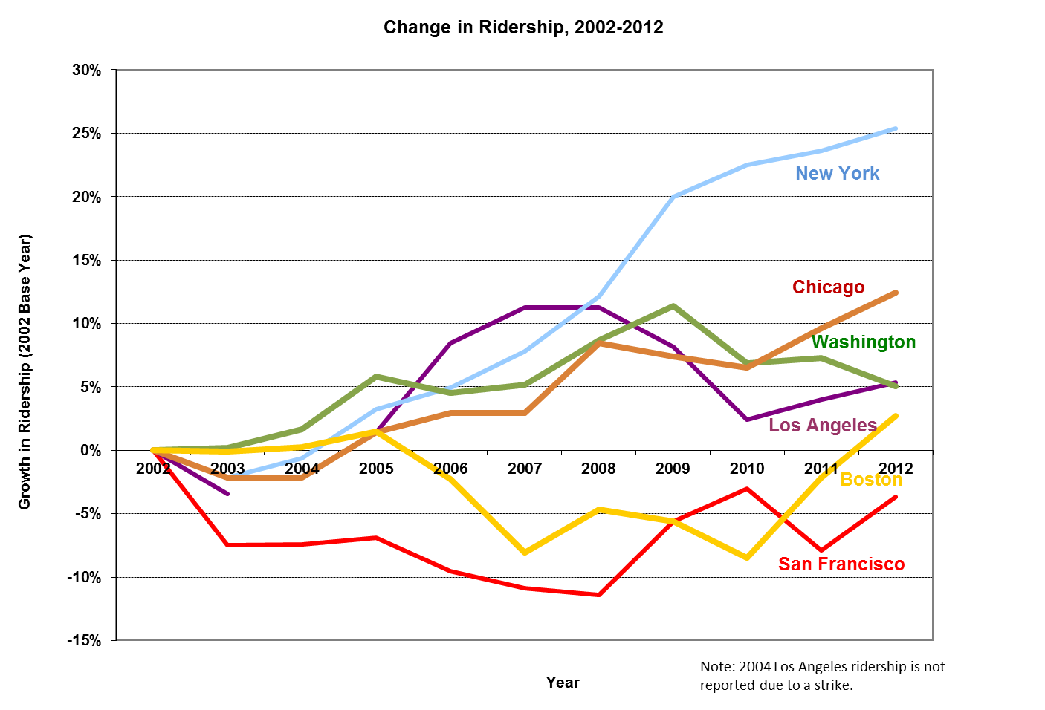
Ridership

